Slide 1

Get the full version of this framework and access our library of hundreds of other business resources.
You Exec provides business resources that move your career forward. Access our full library of presentations, spreadsheet models, and business book summaries. We do the work, you take the credit.
Join You Exec Plus today and take your career to new heights. Receive premium business resources in your inbox every week.
Errors & Omissions Liability (E&O): You Exec makes no guarantee that the statements, analysis, projections, estimates, graphs, reports, numbers, and any derivatives sourced from this presentation are free of errors and omissions. You Exec assumes no liability for erroneous outcomes derived from this presentation.
Start today
Found an error, have suggestions?
Feedback

Slide 2




20XX
COMPANY
HISTORY
As the leading company in the tech industry with a passion for innovation and excellence, Company XYZ has become a household name in the tech world, known for its groundbreaking products and services.
With a team of highly skilled professionals, Company XYZ is committed to delivering cutting-edge solutions that transform the way people live, work and play.
SECTION
20XX
20XX

Slide 3



MISSION
COMPANY
At Company XYZ, our mission is to be the leading innovator in the tech
MISSION
VISION
SECTION
At Company XYZ, our mission is to be the leading innovator in the tech
At Company XYZ, our mission is to be the leading innovator in the tech industry, providing solutions that enhance people's lives and empower them to achieve their full potential.
VALUES
At Company XYZ, our mission is to be the leading innovator in the tech

Slide 4


OUR SOLUTION APPROACH
By offering tailored solutions that are designed to meet the unique needs of each client, Company XYZ is able to provide unparalleled value and help its clients achieve their goals.
Analytics
Detection
SECTION
Prevention
Intelligence
Response
Collaboration

Slide 5




KEY PRODUCT
BENEFITS
+30%
+50%
+25%
+70%
SECTION
Time saving per task
# Completed tasks
Project completion rate
Employee satisfaction
Intuitive management platform
Real time progress tracking
Automated reminders and alerts
Customizable requirement and scope

Slide 6



OVER
$3 BILLION
200+
Independent Member Firms
In combined revenue generated for our enterprise users
620
Offices
SECTION
110
Countries
Our product allows clients to gain a deeper understanding of customers' needs and behaviors, leading to better satisfaction and loyalty. Many top global firms have already used this to drive profitability.
300+
Special Interest Groups

Slide 7
UPCOMING DEVELOPMENTS
To allow our customers make better informed decisions, our company is developing and will the launching more AI-enabled features, products, & services in the near future. Here’s a sneak peak on what’s in the works.
YEAR 5
Smart home virtual assistants
YEAR 4
AI-powered fraud detection
SECTION
YEAR 3
Predictive maintenance solution
YEAR 2
AI-powered predictive analytics
YEAR 1
AI-enabled smart customer service

Slide 8




In the end Company XYZ made sustainable improvements to our business strategy. We no longer conduct any in-house prospecting, which frees up time for higher-value tasks.
Company XYZ’s all inclusive enterprise solution also provided us a reliable source of high-quality leads, which allowed our marketers to accelerate their goals.
WILLIAM JOHNSON
SECTION
Regional Sales Director, ABC Corp.
Previous
Next

Slide 9
Our team has been using the enterprise package for the past five years and we’ve all be very satisfied. Our workflow has been simplified, and employees can now focus on more fulfilling and revenue-generating tasks instead of mundane busy work.
SECTION
KATHERINE DAWSON
VP of Growth, Awesome Corp.
Previous
Next

Slide 10
GLOBAL PRESENCE AND TALENTS
7,500
Employees worldwide delivering industry expertise, top service, & breakthrough ideas
OUR CULTURE
Operating from 10+ Locations
20+ Partners across the globe
Offers Worldwide services in more than 15 countries
Major Serving
Locations
Headquarters
Offices
Partners

Slide 11






CONTACT US
ADDRESS
3371 Sumner Street, Santa Monica, CA
GET IN TOUCH
PHONE
+01 234 5678 901
EMAIL
support@company.com
SOCIAL
Instagram.com/companyname
Linkedin.com/companyname

Slide 12
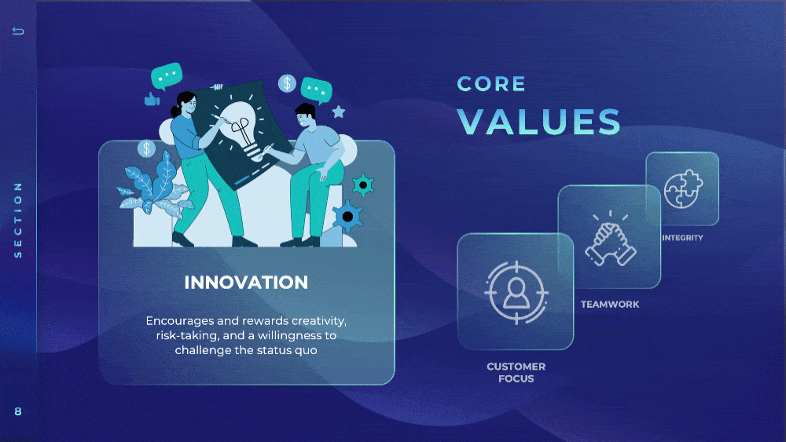
Get the full version of this presentation with this slide when you join You Exec Plus.
Start today

Slide 13

Get the full version of this presentation with this slide when you join You Exec Plus.
Start today

Slide 14

Get the full version of this presentation with this slide when you join You Exec Plus.
Start today

Slide 15

Get the full version of this presentation with this slide when you join You Exec Plus.
Start today

Slide 16

Get the full version of this presentation with this slide when you join You Exec Plus.
Start today

Slide 17




Related
The following resources are related to this framework and can save you hours of work.
If you’re a free or paid member, log into You Exec first for a better download experience.
Corporate Brand
Consulting Proposal
Request for Proposal
Annual Report

